Slide 1






Defining Classes – Part I
Classes, Fields, Constructors, Methods, Properties
Object-Oriented

Slide 2
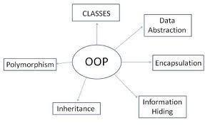

Table of Contents
Defining Simple Classes
Fields
Access Modifiers
Using Classes and Objects
Constructors
Methods
Properties
Enumerations (Enums)
Keeping the Object State

Slide 3

Defining Simple Classes

Slide 4
Classes in OOP
Classes model real-world objects and define
Attributes (state, properties, fields)
Behavior (methods, operations)
Classes describe the structure of objects
Objects describe particular instance of a class
Properties hold information about the modeled object relevant to the problem
Operations implement object behavior

Slide 5
Classes in C#
Classes in C# can have members:
Fields, constants, methods, properties, indexers, events, operators, constructors, destructors, …
Inner types (inner classes, structures, interfaces, delegates, ...)
Members can have access modifiers (scope)
public, private, protected, internal
Members can be
static (common) or specific for a given object

Slide 6
Simple Class Definition
Begin of class definition
public class Cat : Animal {
private string name;
private string owner;
public Cat(string name, string owner)
{
this.name = name;
this.owner = owner;
}
public string Name
{
get { return this.name; }
set { this.name = value; }
}
Inherited (base) class
Fields
Constructor
Property

Slide 7

Simple Class Definition (2)
public string Owner
{
get { return this.owner; }
set { this.owner = value; }
}
public void SayMiau()
{
Console.WriteLine("Miauuuuuuu!");
}
}
Method
End of class definition

Slide 8

Class Definition and Members
Class definition consists of:
Class declaration
Inherited class or implemented interfaces
Fields (static or not)
Constructors (static or not)
Properties (static or not)
Methods (static or not)
Events, inner types, etc.

Slide 9

Fields
Defining and Using Data Fields
Data Fields

Slide 10
Fields
Fields are data members defined inside a class
Fields hold the internal object state
Can be static or per instance
Can be private / public / protected / …
class Dog
{
private string name;
private string breed;
private int age;
protected Color color;
}
Field declarations

Slide 11
Constant Fields
Constant fields are of two types:
Compile-time constants – const
Replaced by their value during the compilation
Runtime constants – readonly
Assigned once only at object creation
class Math
{
public const float PI = 3.14159;
public readonly Color =
Color.FromRGBA(25, 33, 74, 128);
}

Slide 12
Constant Fields – Example
public class Constants
{
public const double PI = 3.1415926535897932385;
public readonly double Size;
public Constants(int size)
{
this.Size = size; // Cannot be further modified!
}
static void Main()
{
Console.WriteLine(Constants.PI);
Constants c = new Constants(5);
Console.WriteLine(c.Size);
c.Size = 10; // Compilation error: readonly field
Console.WriteLine(Constants.Size); // compile error
}
}

Slide 13


Access Modifiers
Public, Private, Protected, Internal

Slide 14
Access Modifiers
Class members can have access modifiers
Used to restrict the classes able to access them
Supports the OOP principle "encapsulation"
Class members can be:
public – accessible from any class
protected – accessible from the class itself and all its descendent classes
private – accessible from the class itself only
internal (default) – accessible from the current assembly, i.e. the current VS project

Slide 15
The 'this' Keyword
The keyword this inside a method points to the current instance of the class
Example:
class Dog
{
private string name;
public void PrintName()
{
Console.WriteLine(this.name);
// The same like Console.WriteLine(name);
}
}

Slide 16

Defining Simple Classes
Example

Slide 17
Task: Define a Class "Dog"
Our task is to define a simple class that represents information about a dog
The dog should have name and breed
Optional fields (could be null)
The class allows to view and modify the name and the breed at any time
The dog should be able to bark
Notes:
Mew = мяукам!

Slide 18

Defining Class Dog – Example
public class Dog {
private string name;
private string breed;
public Dog()
{
}
public Dog(string name, string breed)
{
this.name = name;
this.breed = breed;
}
(the example continues)

Slide 19

Defining Class Dog – Example (2)
public string Name
{
get { return this.name; }
set { this.name = value; }
}
public string Breed
{
get { return this.breed; }
set { this.breed = value; }
}
public void SayBau()
{
Console.WriteLine("{0} said: Bauuuuuu!",
this.name ?? "[unnamed dog]");
}
}

Slide 20

Using Classes and Objects

Slide 21


How to Use Classes (Non-Static)?
Create an instance
Initialize its properties / fields
Manipulate the instance
Read / modify its properties
Invoke methods
Handle events
Release the occupied resources
Performed automatically in most cases

Slide 22
Task: Dog Meeting
Our task is as follows:
Create 3 dogs
The first should be named “Sharo”, the second – “Rex” and the last – left without name
Put all dogs in an array
Iterate through the array elements and ask each dog to bark
Note:
Use the Dog class from the previous example!

Slide 23
Dog Meeting – Example
static void Main()
{
Console.Write("Enter first dog's name: ");
string dogName = Console.ReadLine();
Console.Write("Enter first dog's breed: ");
string dogBreed = Console.ReadLine();
// Use the Dog constructor to assign name and breed
Dog firstDog = new Dog(dogName, dogBreed);
// Use Dog's parameterless constructor
Dog secondDog = new Dog();
// Use properties to assign name and breed
Console.Write("Enter second dog's name: ");
secondDog.Name = Console.ReadLine();
Console.Write("Enter second dog's breed: ");
secondDog.Breed = Console.ReadLine();
(the example continues)

Slide 24
Dog Meeting – Example (2)
// Create a Dog with no name and breed
Dog thirdDog = new Dog();
// Save the dogs in an array
Dog[] dogs = new Dog[] {
firstDog, secondDog, thirdDog };
// Ask each of the dogs to bark
foreach(Dog dog in dogs)
{
dog.SayBau();
}
}

Slide 25

Dog Meeting
Live Demo

Slide 26
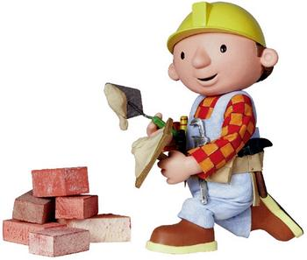
Constructors
Defining and Using Class Constructors

Slide 27
What is Constructor?
Constructors are special methods
Invoked at the time of creating a new instance of an object
Used to initialize the fields of the instance
Constructors has the same name as the class
Have no return type
Can have parameters
Can be private, protected, internal, public

Slide 28

Defining Constructors
Class Point with parameterless constructor:
public class Point
{
private int xCoord;
private int yCoord;
// Simple parameterless constructor
public Point()
{
this.xCoord = 0;
this.yCoord = 0;
}
// More code …
}

Slide 29

Defining Constructors (2)
public class Person
{
private string name;
private int age;
// Parameterless constructor
public Person()
{
this.name = null;
this.age = 0;
}
// Constructor with parameters
public Person(string name, int age)
{
this.name = name;
this.age = age;
}
// More code …
}
As rule constructors should initialize all own class fields.

Slide 30
Constructors and Initialization
Pay attention when using inline initialization!
public class AlarmClock
{
private int hours = 9; // Inline initialization
private int minutes = 0; // Inline initialization
// Parameterless constructor (intentionally left empty)
public AlarmClock()
{ }
// Constructor with parameters
public AlarmClock(int hours, int minutes)
{
this.hours = hours; // Invoked after the inline
this.minutes = minutes; // initialization!
}
// More code …
}

Slide 31

Chaining Constructors Calls
Reusing constructors (chaining)
public class Point
{
private int xCoord;
private int yCoord;
public Point() : this(0, 0) // Reuse the constructor
{
}
public Point(int xCoord, int yCoord)
{
this.xCoord = xCoord;
this.yCoord = yCoord;
}
// More code …
}

Slide 32

Constructors
Live Demo

Slide 33
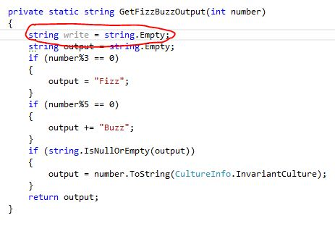


Methods
Defining and Invoking Methods

Slide 34
Methods
Methods are class members that execute some action (some code, some algorithm)
Could be static / per instance
Could be public / private / protected / …
public class Point
{
private int xCoord;
private int yCoord;
public double CalcDistance(Point p)
{
return Math.Sqrt(
(p.xCoord - this.xCoord) * (p.xCoord - this.xCoord) +
(p.yCoord - this.yCoord) * (p.yCoord - this.yCoord));
}
}

Slide 35
Using Methods
Invoking instance methods is done through the object (class instance):
class TestMethods
{
static void Main()
{
Point p1 = new Point(2, 3);
Point p2 = new Point(3, 4);
System.Console.WriteLine(p1.CalcDistance(p2));
}
}

Slide 36
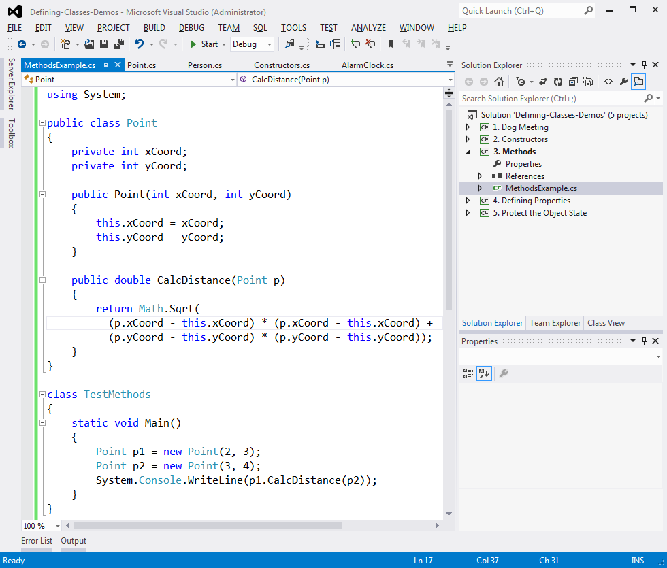
Methods
Live Demo

Slide 37
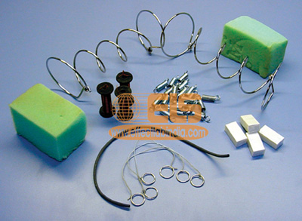
Properties
Defining and Using Properties

Slide 38
The Role of Properties
Properties expose object's data to the world
Control how the data is manipulated
Ensure the internal object state is correct
E.g. price should always be kept positive
Properties can be:
Read-only
Write-only
Read and write
Simplify the writing of code

Slide 39
Defining Properties
Properties work as a pair of methods
Getter and setter
Properties should have:
Access modifier (public, protected, etc.)
Return type
Unique name
Get and / or Set part
Can contain code processing data in specific way, e.g. apply validation

Slide 40
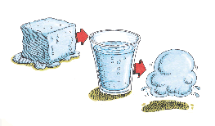
Defining Properties – Example
public class Point
{
private int xCoord;
private int yCoord;
public int XCoord
{
get { return this.xCoord; }
set { this.xCoord = value; }
}
public int YCoord
{
get { return this.yCoord; }
set { this.yCoord = value; }
}
// More code ...
}

Slide 41
Dynamic Properties
Properties are not obligatory bound to a class field – can be calculated dynamically:
public class Rectangle
{
private double width;
private double height;
// More code …
public double Area
{
get
{
return width * height;
}
}
}

Slide 42
Automatic Properties
Properties could be defined without an underlying field behind them
It is automatically created by the compiler
class UserProfile
{
public int UserId { get; set; }
public string FirstName { get; set; }
public string LastName { get; set; }
}
…
UserProfile profile = new UserProfile() {
FirstName = "Steve",
LastName = "Balmer",
UserId = 91112
};

Slide 43

Properties
Live Demo

Slide 44

Enumerations
Defining and Using Enumerated Types

Slide 45
Enumerations in C#
Enumerations are types that hold a value from a fixed set of named constants
Declared by enum keyword in C#
public enum DayOfWeek
{
Mon, Tue, Wed, Thu, Fri, Sat, Sun
}
class EnumExample
{
static void Main()
{
DayOfWeek day = DayOfWeek.Wed;
Console.WriteLine(day); // Wed
}
}

Slide 46
Enumerations – Example
public enum CoffeeSize
{
Small = 100, Normal = 150, Double = 300
}
public class Coffee
{
public CoffeeSize size;
public Coffee(CoffeeSize size)
{
this.size = size;
}
public CoffeeSize Size
{
get { return size; }
}
}
(the example continues)

Slide 47
Enumerations – Example (2)
public class CoffeeMachine
{
static void Main()
{
Coffee normalCoffee = new Coffee(CoffeeSize.Normal);
Coffee doubleCoffee = new Coffee(CoffeeSize.Double);
Console.WriteLine("The {0} coffee is {1} ml.",
normalCoffee.Size, (int)normalCoffee.Size);
// The Normal coffee is 150 ml.
Console.WriteLine("The {0} coffee is {1} ml.",
doubleCoffee.Size, (int)doubleCoffee.Size);
// The Double coffee is 300 ml.
}
}

Slide 48

Enumerations
Live Demo

Slide 49


Keeping the Object State Correct

Slide 50
Keep the Object State Correct
Constructors and properties can keep the object's state correct
This is known as encapsulation in OOP
Can force validation when creating / modifying the object's internal state
Constructors define which properties are mandatory and which are optional
Property setters should validate the new value before saving it in the object field
Invalid values should cause an exception

Slide 51
Keep the Object State – Example
public class Person
{
private string name;
public Person(string name)
{
this.Name = name;
}
public string Name
{
get { return this.name; }
set
{
if (String.IsNullOrEmpty(value))
throw new ArgumentException("Invalid name!");
this.name = value;
}
}
}
We have only one constructor, so we cannot create person without specifying a name.
Incorrect name cannot be assigned

Slide 52

Keeping the Object State Correct
Live Demo

Slide 53
Summary
Classes define specific structure for objects
Objects are particular instances of a class
Classes define fields, methods, constructors, properties and other members
Access modifiers limit the access to class members
Constructors are invoked when creating new class instances and initialize the object's internal state
Enumerations define a fixed set of constants
Properties expose the class data in safe, controlled way

Slide 54



Defining Classes – Part I
Questions?
http://academy.telerik.com

Slide 55
Exercises
Define a class that holds information about a mobile phone device: model, manufacturer, price, owner, battery characteristics (model, hours idle and hours talk) and display characteristics (size and number of colors). Define 3 separate classes (class GSM holding instances of the classes Battery and Display).
Define several constructors for the defined classes that take different sets of arguments (the full information for the class or part of it). Assume that model and manufacturer are mandatory (the others are optional). All unknown data fill with null.
Add an enumeration BatteryType (Li-Ion, NiMH, NiCd, …) and use it as a new field for the batteries.

Slide 56
Exercises (2)
Add a method in the GSM class for displaying all information about it. Try to override ToString().
Use properties to encapsulate the data fields inside the GSM, Battery and Display classes. Ensure all fields hold correct data at any given time.
Add a static field and a property IPhone4S in the GSM class to hold the information about iPhone 4S.
Write a class GSMTest to test the GSM class:
Create an array of few instances of the GSM class.
Display the information about the GSMs in the array.
Display the information about the static property IPhone4S.

Slide 57
Exercises (3)
Create a class Call to hold a call performed through a GSM. It should contain date, time, dialed phone number and duration (in seconds).
Add a property CallHistory in the GSM class to hold a list of the performed calls. Try to use the system class List<Call>.
Add methods in the GSM class for adding and deleting calls from the calls history. Add a method to clear the call history.
Add a method that calculates the total price of the calls in the call history. Assume the price per minute is fixed and is provided as a parameter.

Slide 58
Exercises (4)
Write a class GSMCallHistoryTest to test the call history functionality of the GSM class.
Create an instance of the GSM class.
Add few calls.
Display the information about the calls.
Assuming that the price per minute is 0.37 calculate and print the total price of the calls in the history.
Remove the longest call from the history and calculate the total price again.
Finally clear the call history and print it.

Slide 59




Free Trainings @ Telerik Academy
C# Programming @ Telerik Academy
csharpfundamentals.telerik.com
Telerik Software Academy
academy.telerik.com
Telerik Academy @ Facebook
facebook.com/TelerikAcademy
Telerik Software Academy Forums
forums.academy.telerik.com

